Slide 1
JavaScript ES7, ES8, ES9, ES10, ES11
by Yuliia Tsurkan

Slide 2
ECMAScript
2016(ES7)

Slide 3
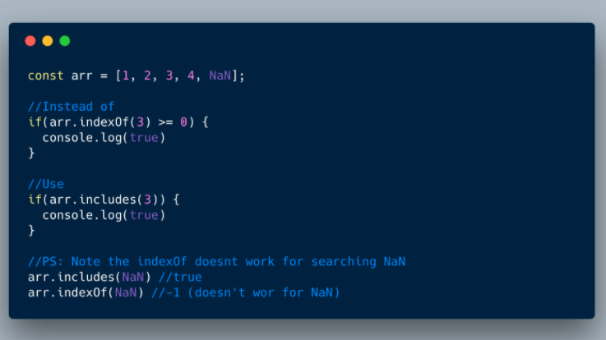
1. Array.prototype.includes()

Slide 4
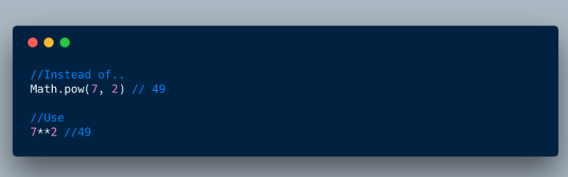
2. Exponentiation operator

Slide 5
ECMAScript
2017(ES8)

Slide 6
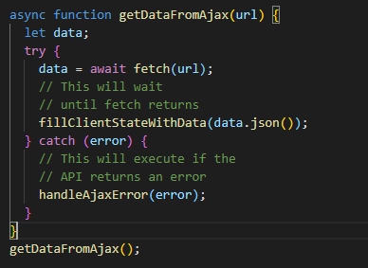
1. Async Functions

Slide 7
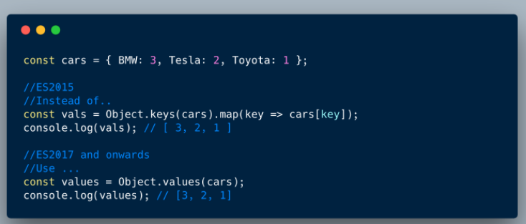
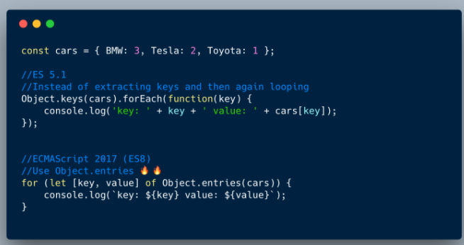
2. Object.values(); 3.Object.entries()

Slide 8
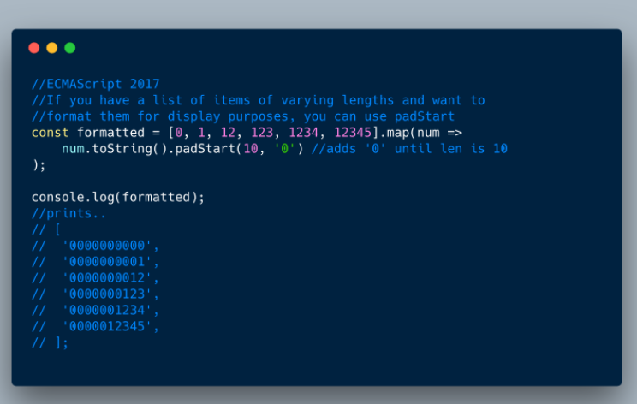
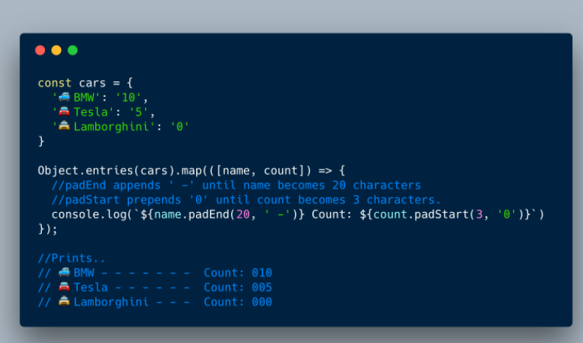
4. padStart(); 5. padEnd();

Slide 9
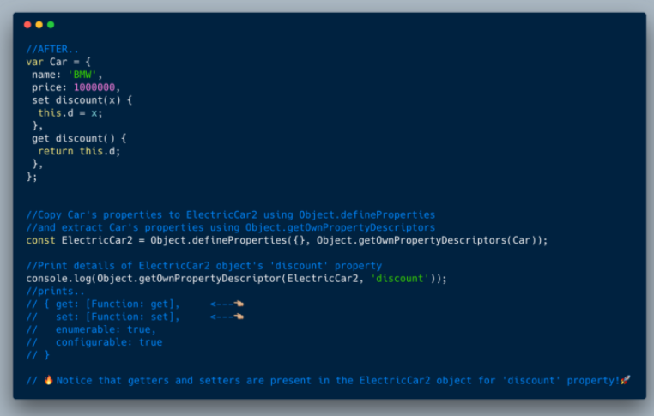
6. Object.getOwnPropertyDescriptors()

Slide 10
ECMAScript
2018(ES9)

Slide 11
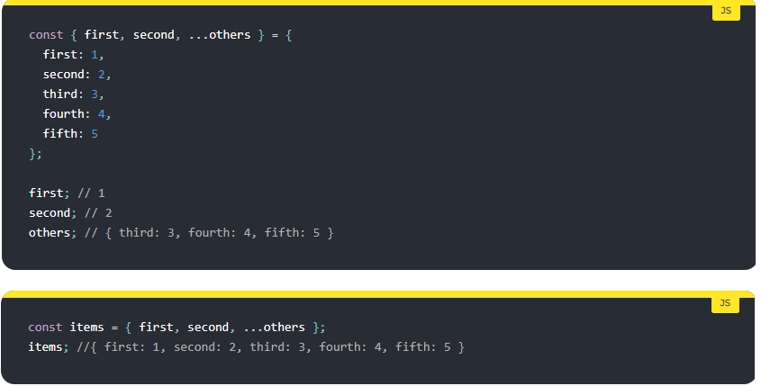
1. Rest/Spread Properties

Slide 12
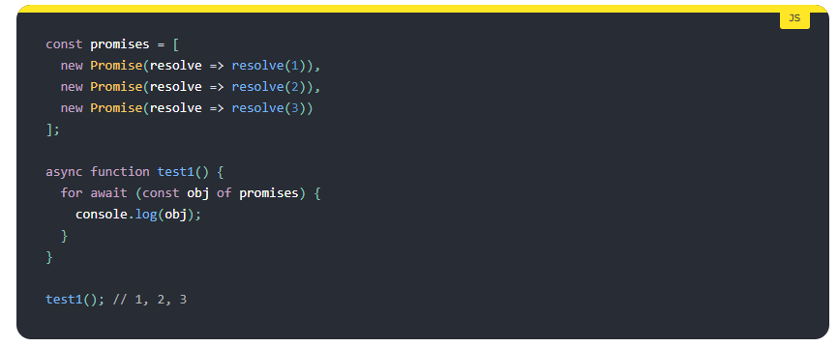
2. Asynchronous Iteration

Slide 13
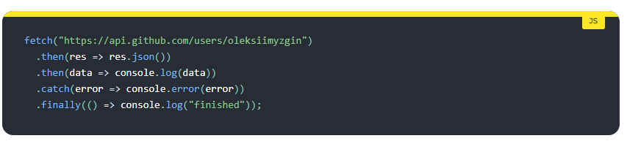
3. Promise.prototype.finally()

Slide 14
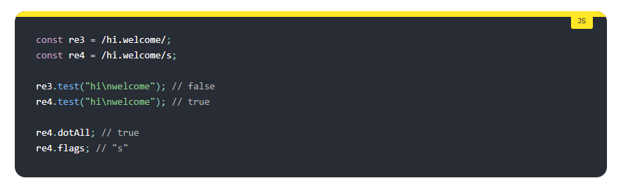
4. Regular expression improvements

Slide 15
ECMAScript
2019(ES10)

Slide 16
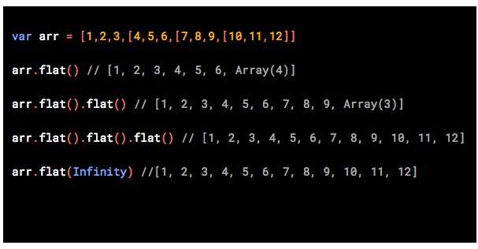
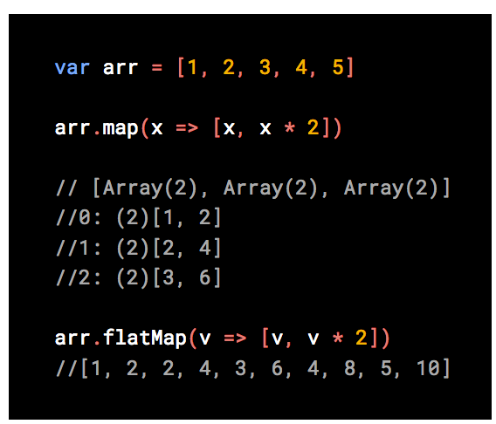
1-2. Array.flat() and Array.flatMap()

Slide 17
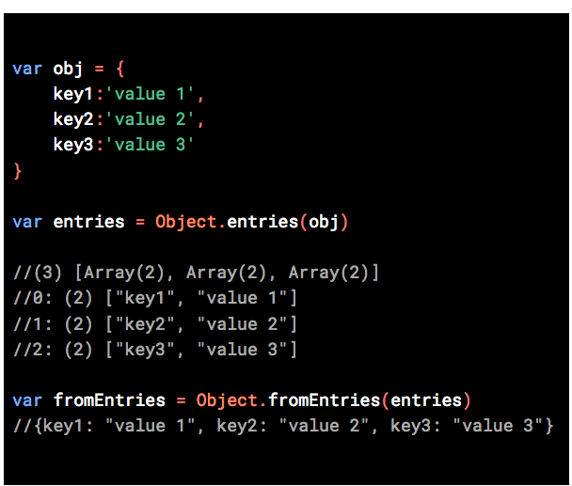
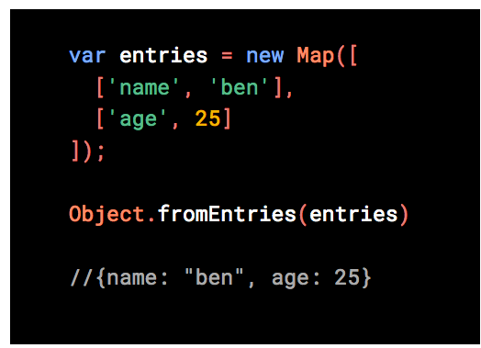
3.Object.fromEntries()

Slide 18
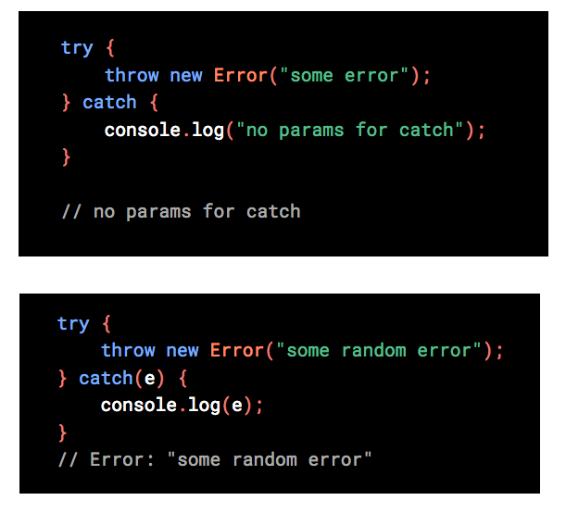
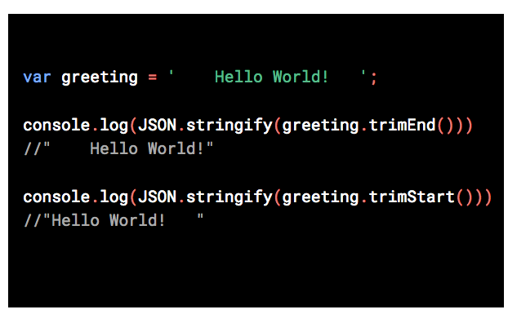
4-5. String.trimStart() & String.trimEnd()
6. Optional Catch Binding

Slide 19
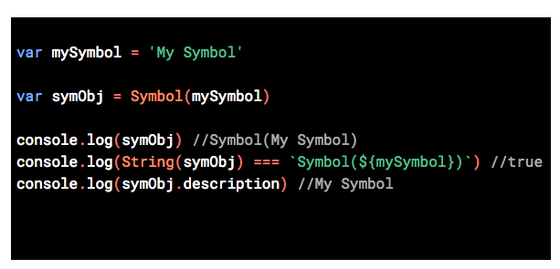
7. Symbol.description

Slide 20
ECMAScript
2020(ES11)

Slide 21
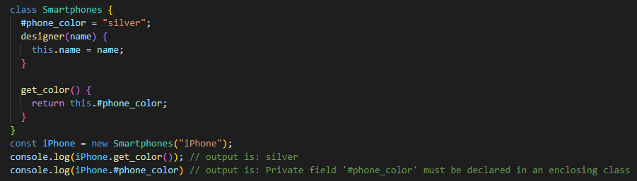
1. Private Fields

Slide 22
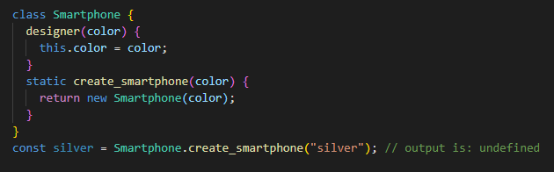
2. Static Fields

Slide 23
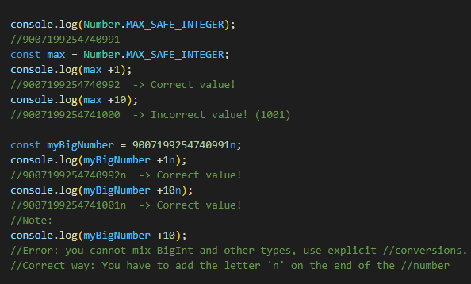
3. BigInt

Slide 24
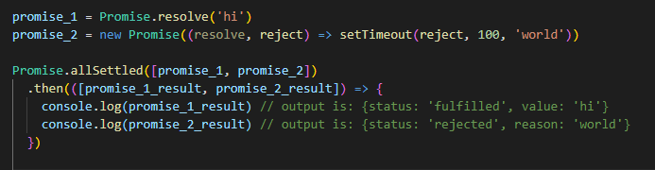
4. Promise.allSettled

Slide 25
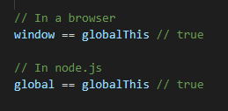
5. globalThis

Slide 26


